Slide 1


ITL528
Learner Profiles
Notes:
Voiceover:

Slide 2
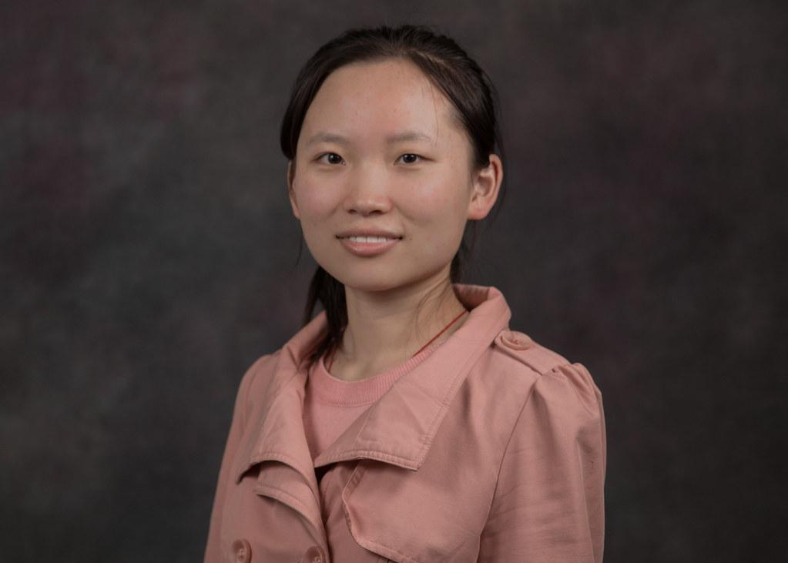
FS 1 Secondary Student: Jun
Jun is a high school student that immigrated to the United States from China during middle school. Jun is bilingual and can speak English and Chinese. She has high academic achievement in math, and music. Jun plays the flute in the schools marching band. Jun works hard in class but struggles significantly with writing. Her notes demonstrate poor English grammar, spelling and syntax. Jun scored Level 4 “Bridging” on the ELPAC test. She is reading at grade level but struggles with reading comprehension for grade level texts. She needs support with vocabulary development and struggles with academic language. She can express herself with scaffolding techniques like graphic organizers and sentence stems.

Slide 3
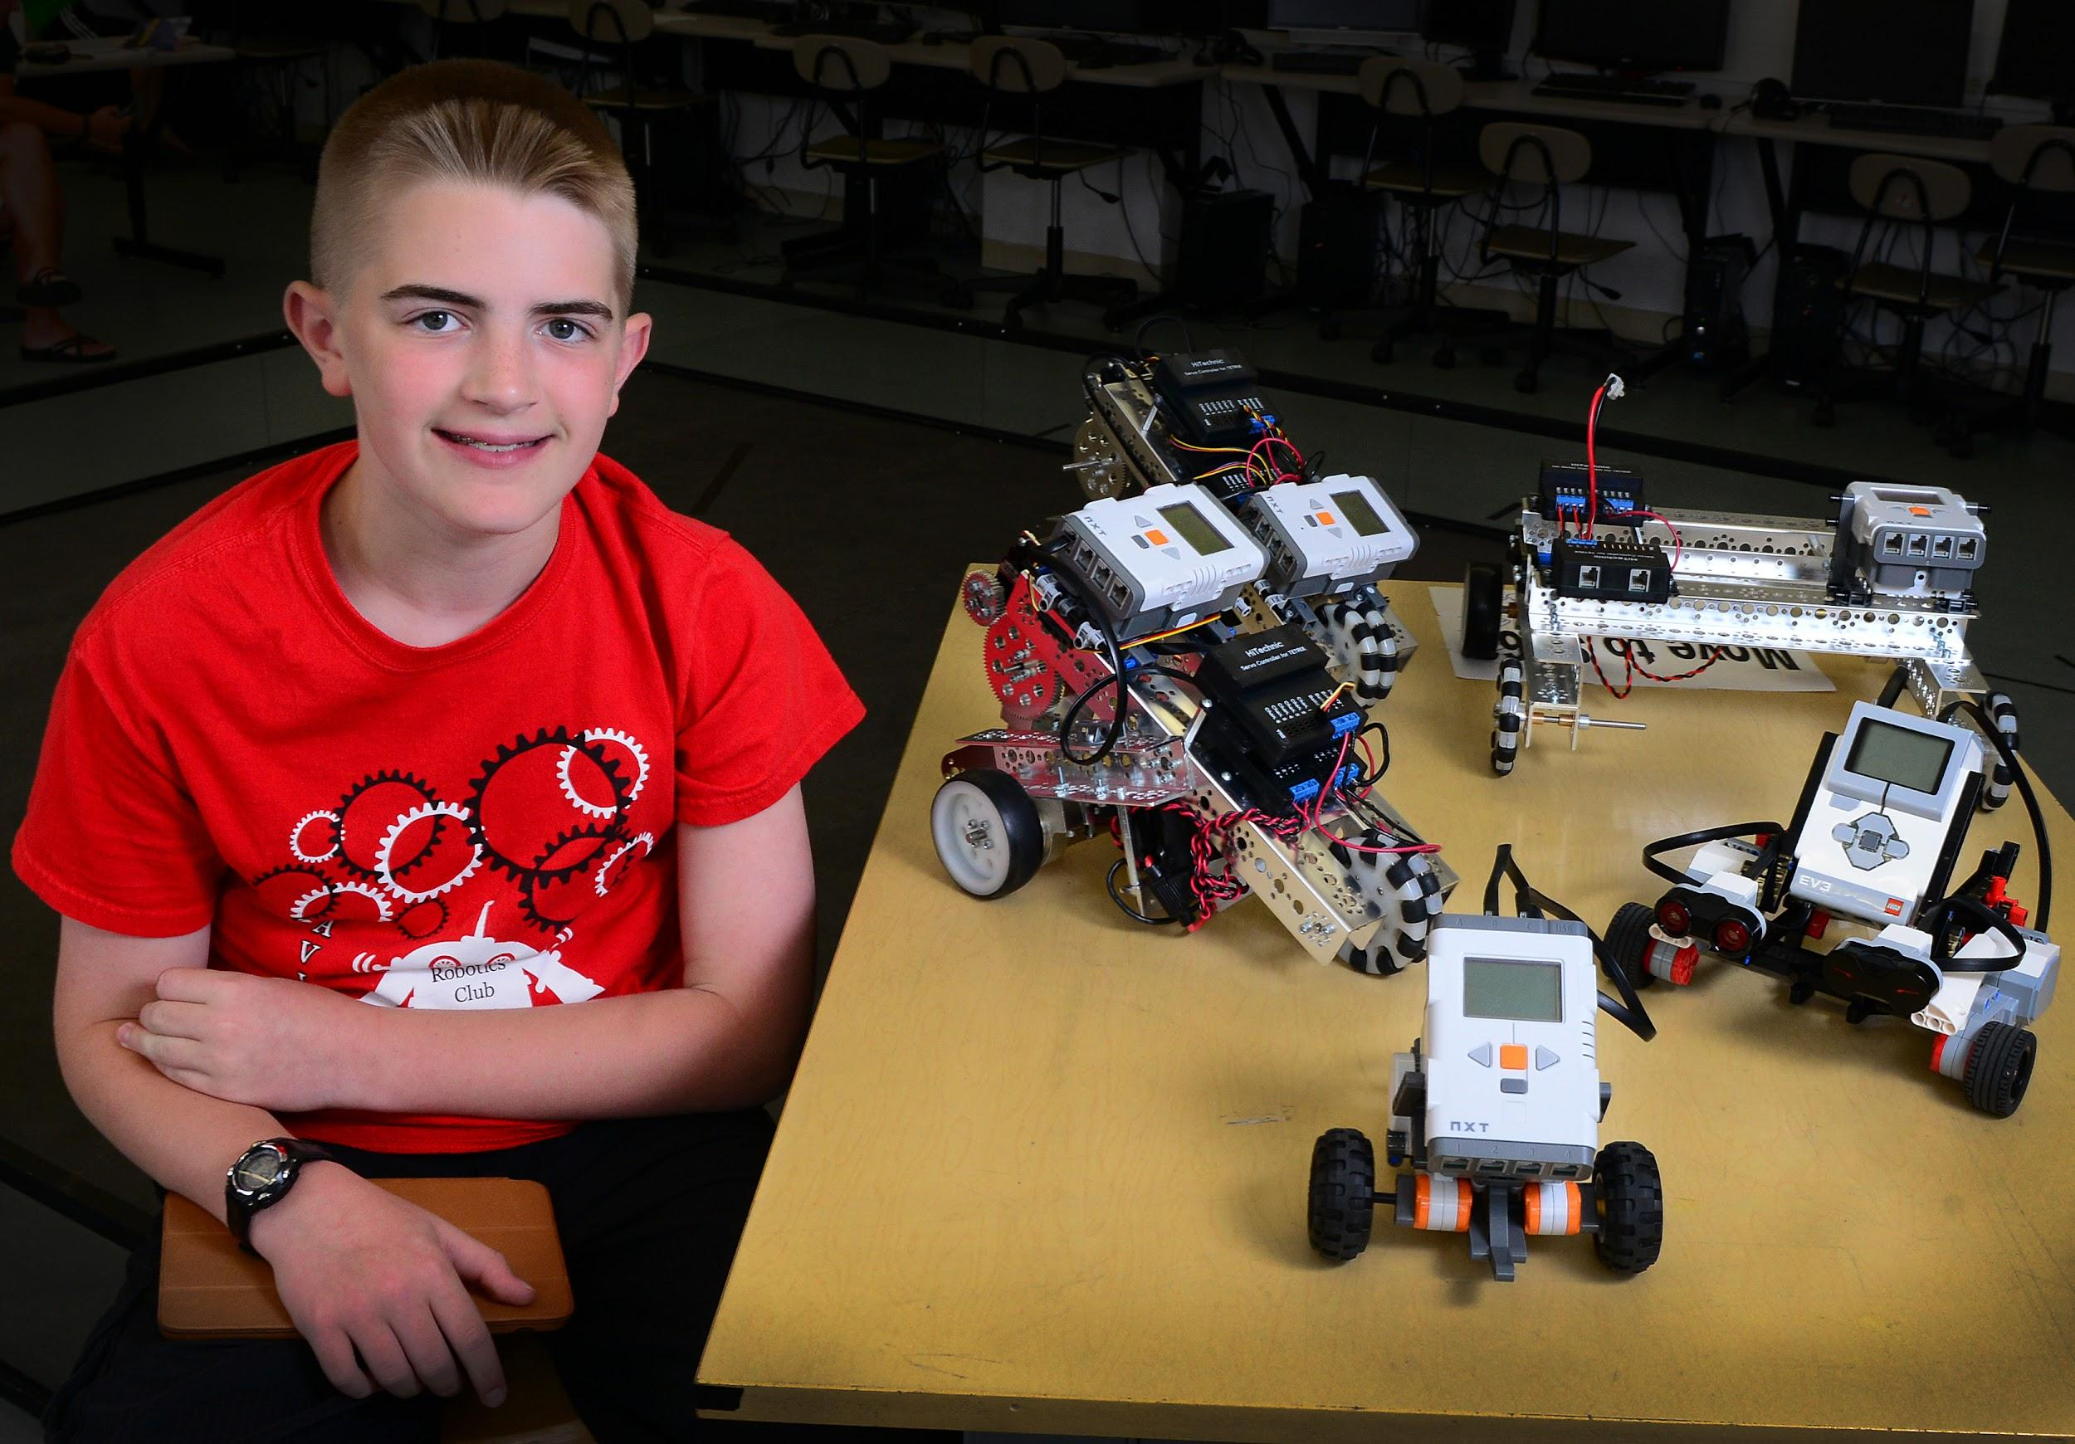
FS 2 Secondary Student: Juan
Juan is an eighth-grade student who has an IEP for Specific Learning Disabilities. He received services throughout elementary school to support deficits in communication skills and social interactions. Juan is involved in the school’s robotic club and has won national competitions. Although Juan excels in math and science, he has a difficulty with Common Core math as it focuses on explaining his thinking and multiple solutions. Juan receives accommodations for reading and writing which includes voice to text assistive technology. See IEP at the following link:
IEP at a Glance

Slide 4
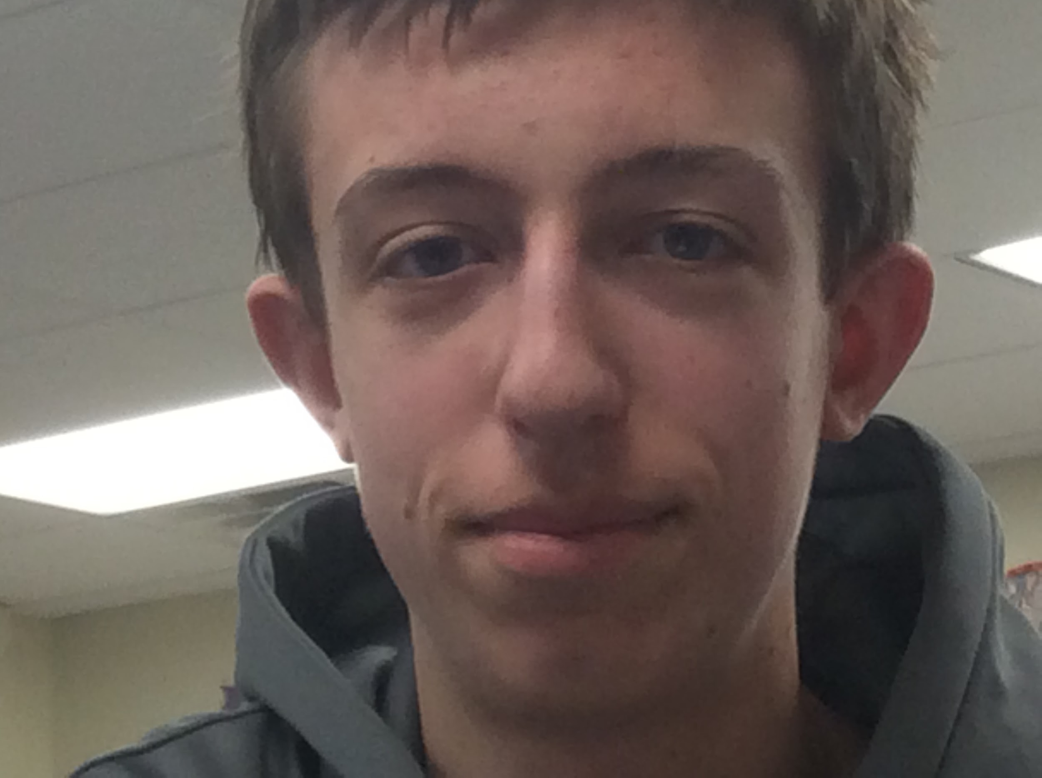
FS 3 Secondary Student: Benji
Benji is a high school student who lives with his mom and visits his dad every other weekend. He is a quiet student who needs encouragement to interact with peers. Benji is interested in art and loves to listen to music. Although his teachers have commented on his academic potential, his grades are low as he often does not turn in assignments or study for his tests. Benji’s grades have dropped significantly since his parent’s divorce in middle school. Rather than taking notes you have observed him drawing in his sketch pad.

Slide 5
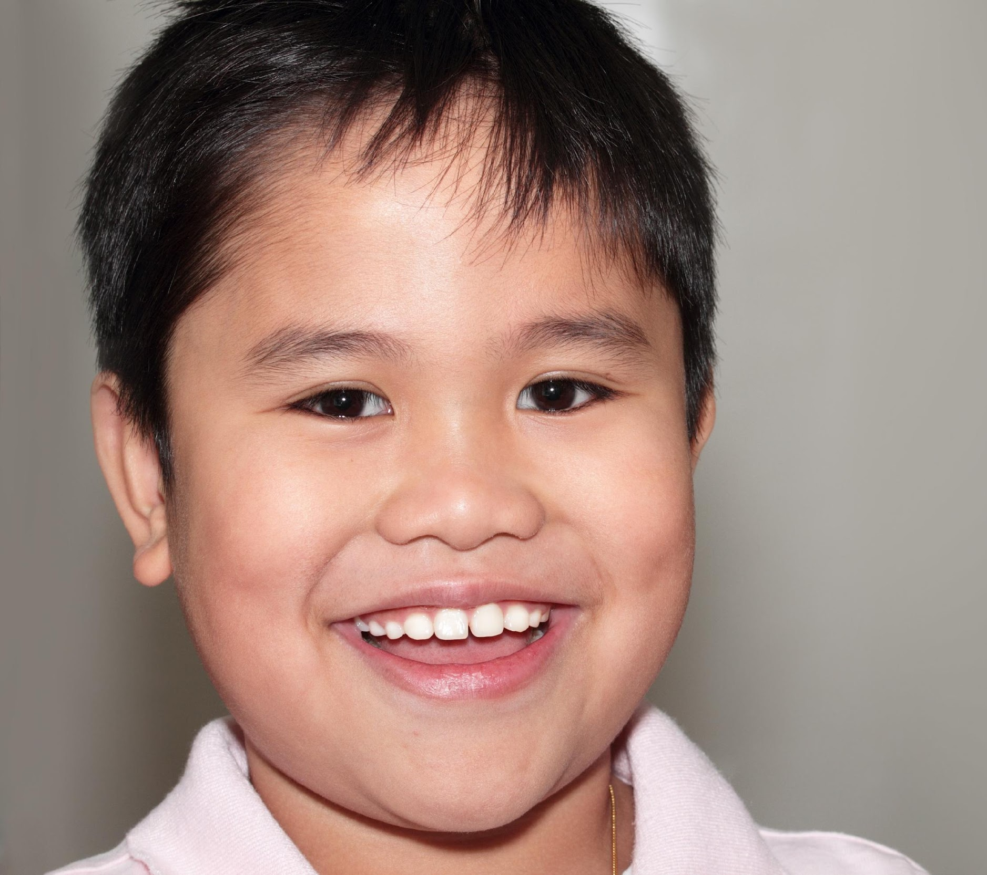
Middle School Student: Johnny
Johnny is a male student whose parents immigrated to the United States from the Philippines before he was born. He has frequent absences and often comes to school late and hungry. Johnny is very social and enjoys working collaboratively with his peers. He loves trading Pokemon cards and organizing sports games during recess. Johnny catches onto concepts quickly in math, but he struggles with reading. His grade-level equivalency, according to Fontas and Pinnell, is two years behind his classmates. At times, he appears depressed. The parent is difficult to contact, and you have wondered if he might be homeless as he is not forthcoming about where he lives.

Slide 6
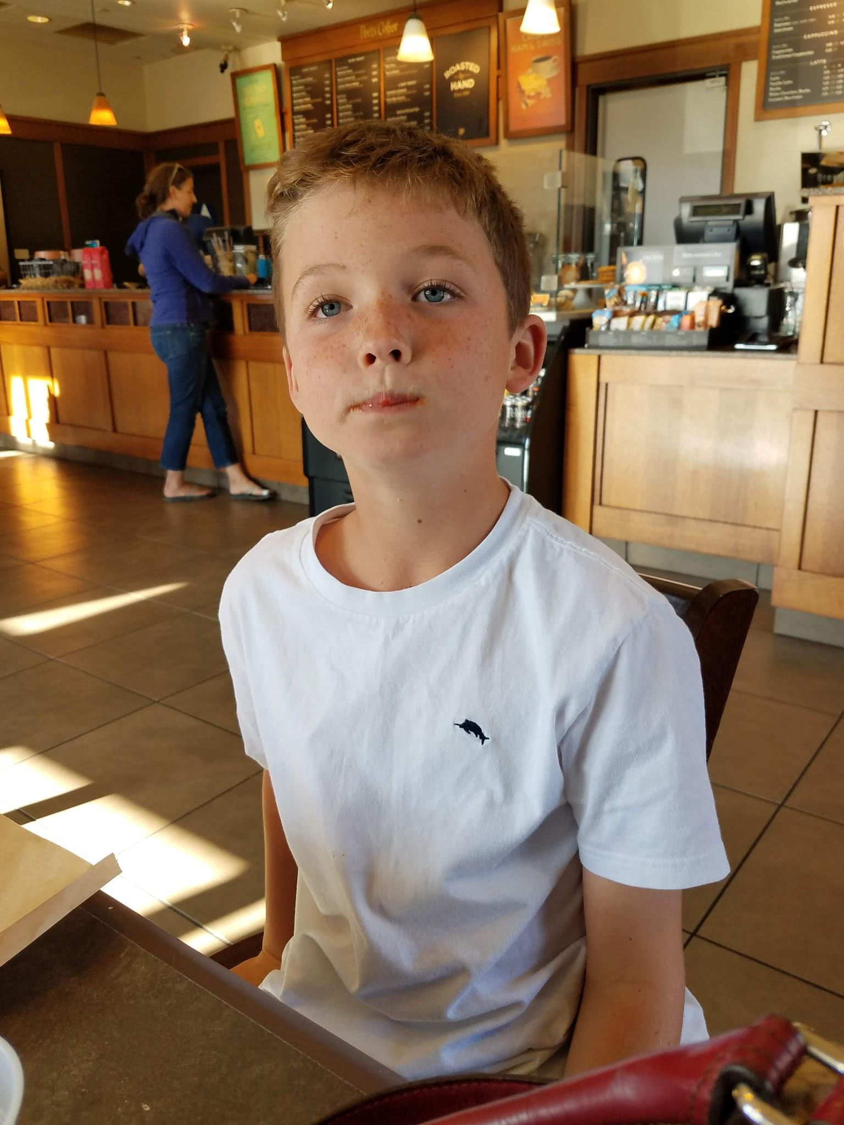
Middle School Student: Jake
Jake is a Caucasian student who loves science and being outdoors. Jake has an IEP for Speech and Language Impairment. He has difficulty with pronouncing sounds and is reading at a kindergarten level. Even though Jake appears to be listening he has a hard time following directions or remembering what he is supposed to be doing. His IEP includes accommodations such as visual cues and extended time. Jake enjoys projects that allow him to have hands on experiences and using manipulatives. See IEP and goals at the following link:
IEP at a Glance

Slide 7

Middle School Student: Maricela
Maricela is a female Hispanic student who has a positive disposition and many friends. She has been in the United states for only two years. Maricela’s parents do not speak English but are very involved in their daughter’s education. Although Maricela always looks busy, she does not generate much work. She scored at Level 2 “Expanding” on the ELPAC. Maricela can solve basic math problems but struggles with word problems. She has developed fluency with reading but struggles with comprehension. Maricela loves art and frequently spends time drawing during her recess and lunch.

